Slide 2
Week 4
Modelling continuous outcomes

Slide 3

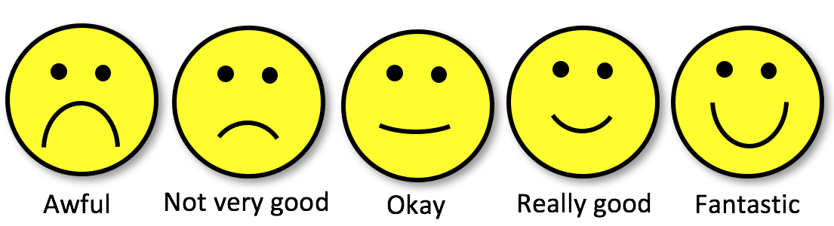
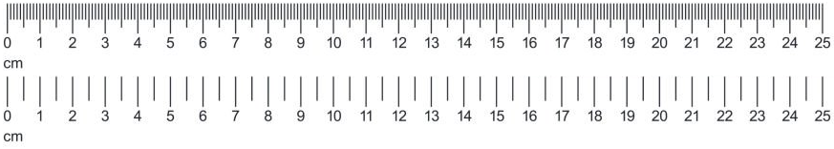
Continuous outcomes?
Categorical:
Nominal
Variable
types
/
Measurement
levels
Categorical:
Ordinal
Scale/Numeric:
Discrete,
Ratio,
Interval

Slide 4
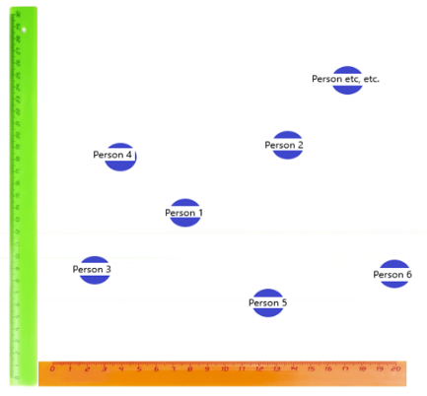
Continuous outcomes?
Dependent / Outcome
Variable
The variable we want to explain/predict
Independent
Variable
The variable we want to use for explaining/predicting the DV

Slide 5
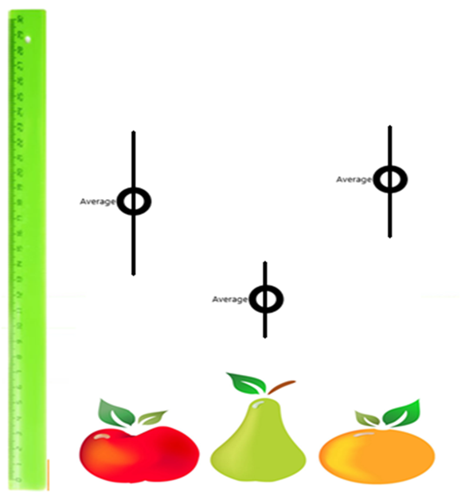
Continuous outcomes?
Dependent / Outcome
Variable
The variable we want to explain/predict
Independent
Variable
The variable we want to use for explaining/predicting the DV

Slide 6
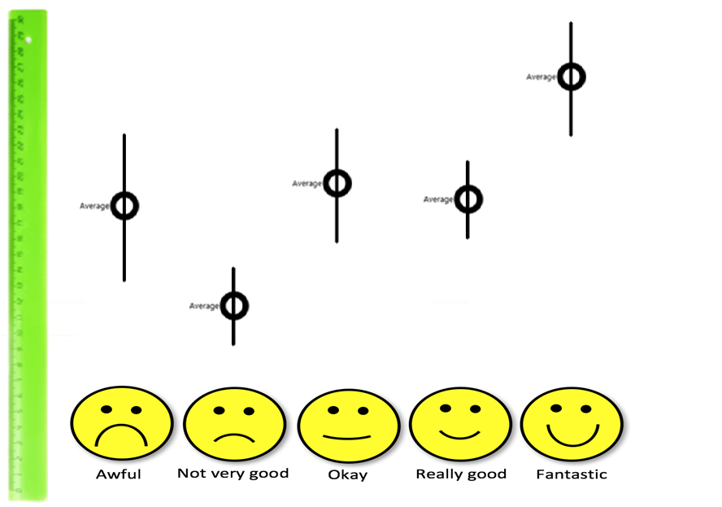
Continuous outcomes?
Dependent / Outcome
Variable
The variable we want to explain/predict
Independent
Variable
The variable we want to use for explaining/predicting the DV

Slide 7
Does inequality explain social trust?

Slide 8
Does inequality explain social trust?
Inequality as a predictor of social trust
Social trust as a function of inequality
A model of social trust dependent on inequality
…

Slide 9
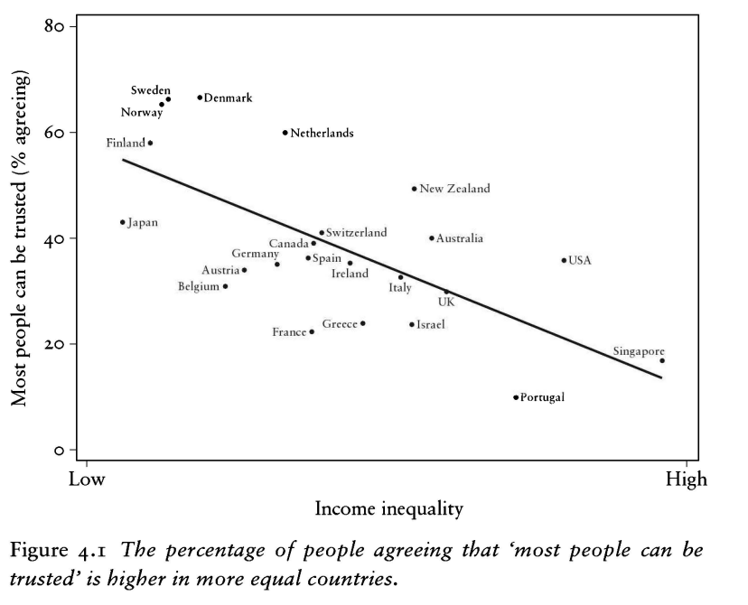

The spirit level (2010)

Slide 10
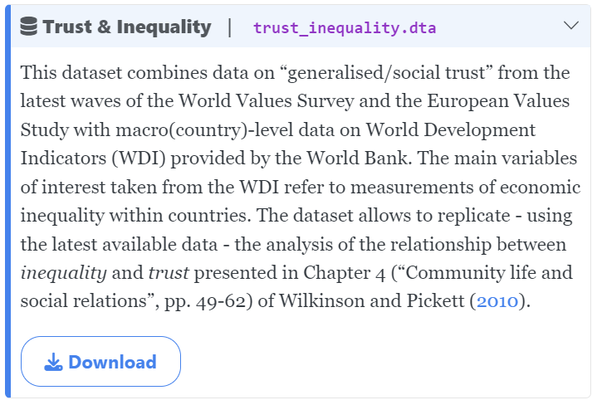
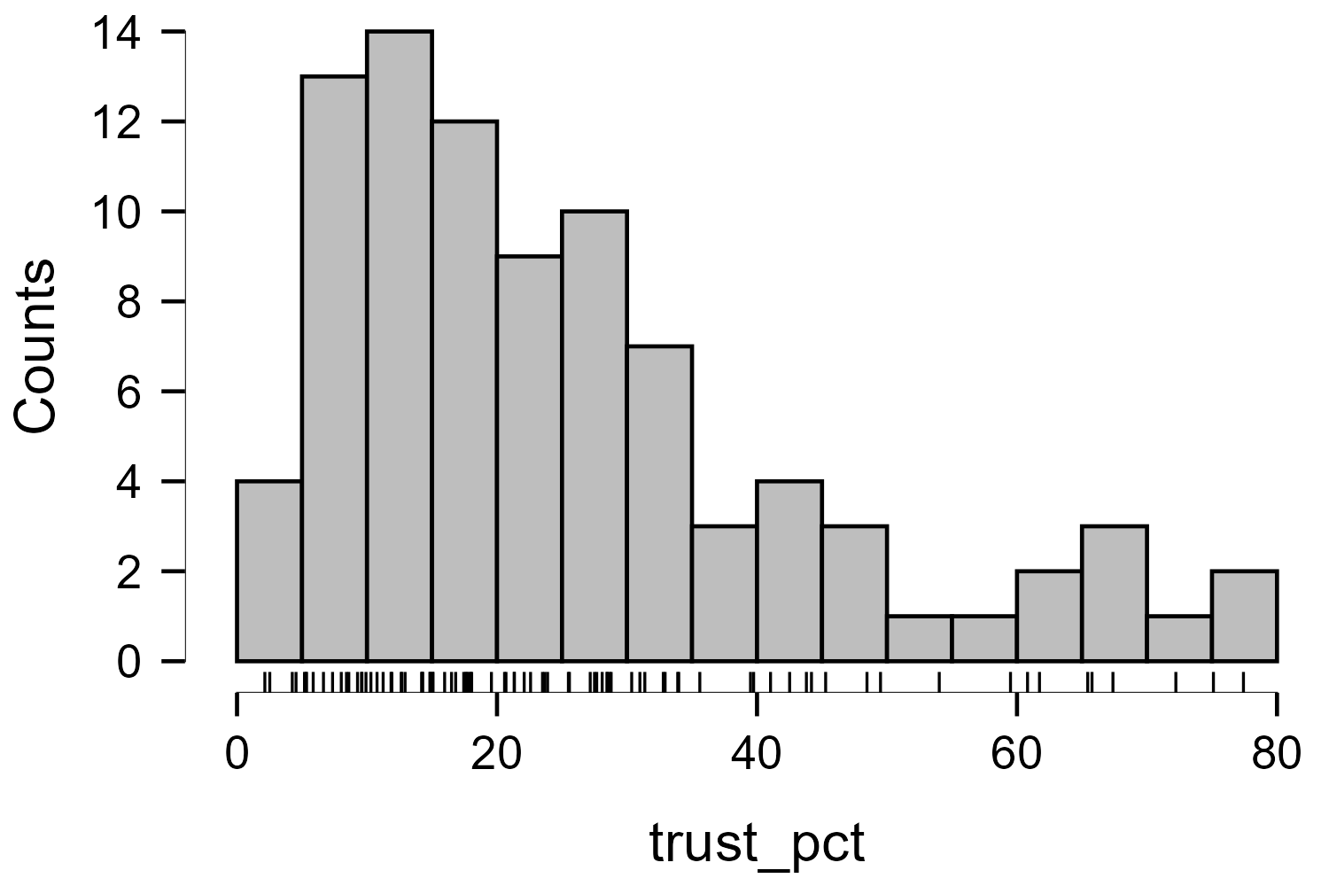
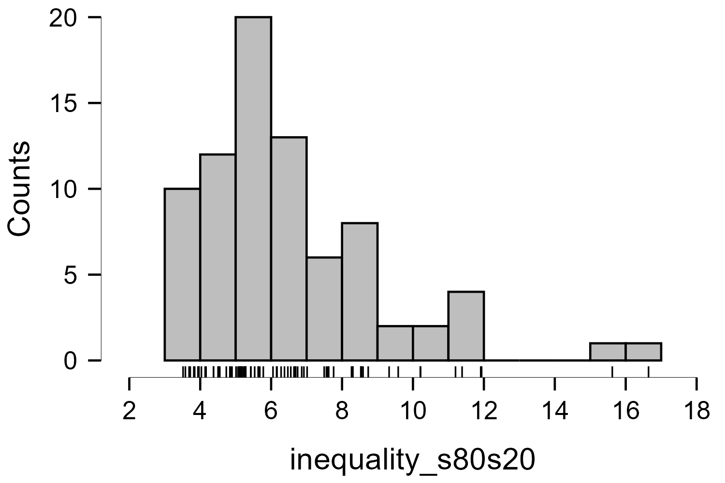
The spirit level (2010): replication data
Descriptive Statistics
 | trust_pct | inequality_s80s20
Valid | 89 | 79
Missing | 0 | 10
Mean | 25.731 | 6.504
Std. Deviation | 18.406 | 2.597
Minimum | 2.140 | 3.517
Maximum | 77.420 | 16.644
https://cgmoreh.github.io/SOC2069-QUANT/Data/

Slide 11
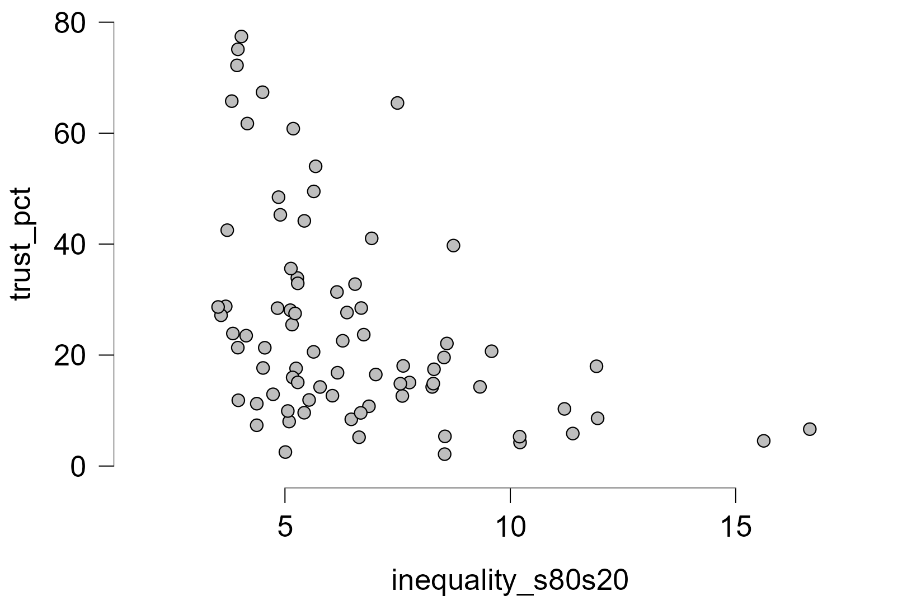
Inequality ←→ Social trust
Descriptive Statistics
 | trust_pct | inequality_s80s20
Valid | 89 | 79
Missing | 0 | 10
Mean | 25.731 | 6.504
Std. Deviation | 18.406 | 2.597
Minimum | 2.140 | 3.517
Maximum | 77.420 | 16.644

Slide 12
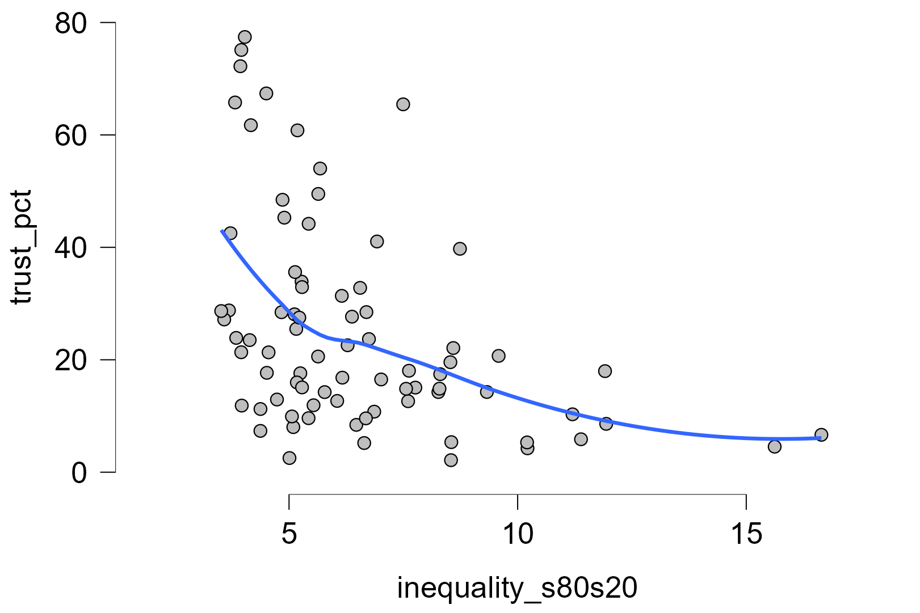
Inequality ←→ Social trust
Descriptive Statistics
 | trust_pct | inequality_s80s20
Valid | 89 | 79
Missing | 0 | 10
Mean | 25.731 | 6.504
Std. Deviation | 18.406 | 2.597
Minimum | 2.140 | 3.517
Maximum | 77.420 | 16.644

Slide 13
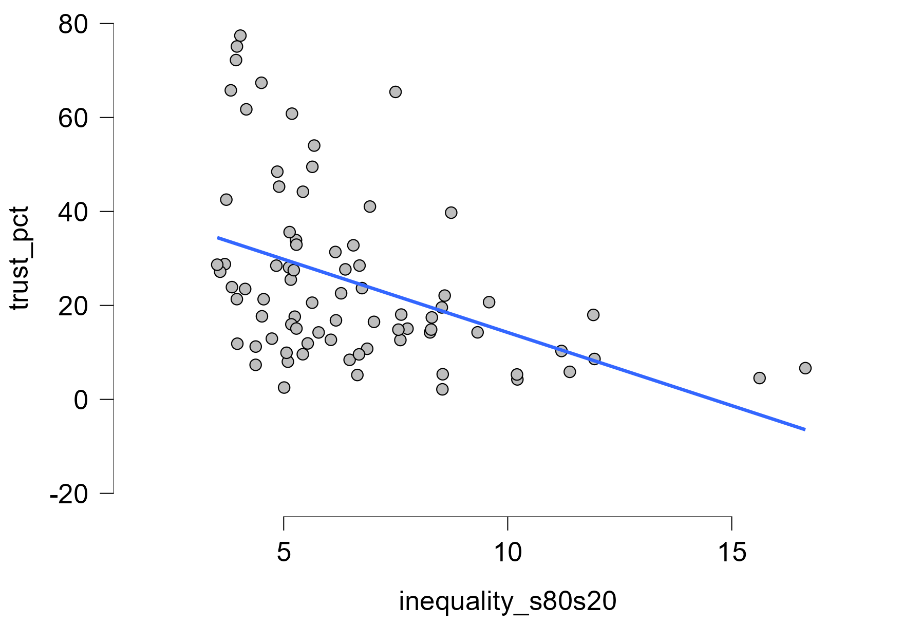
Inequality → Social trust
Descriptive Statistics
 | trust_pct | inequality_s80s20
Valid | 89 | 79
Missing | 0 | 10
Mean | 25.731 | 6.504
Std. Deviation | 18.406 | 2.597
Minimum | 2.140 | 3.517
Maximum | 77.420 | 16.644

Slide 14
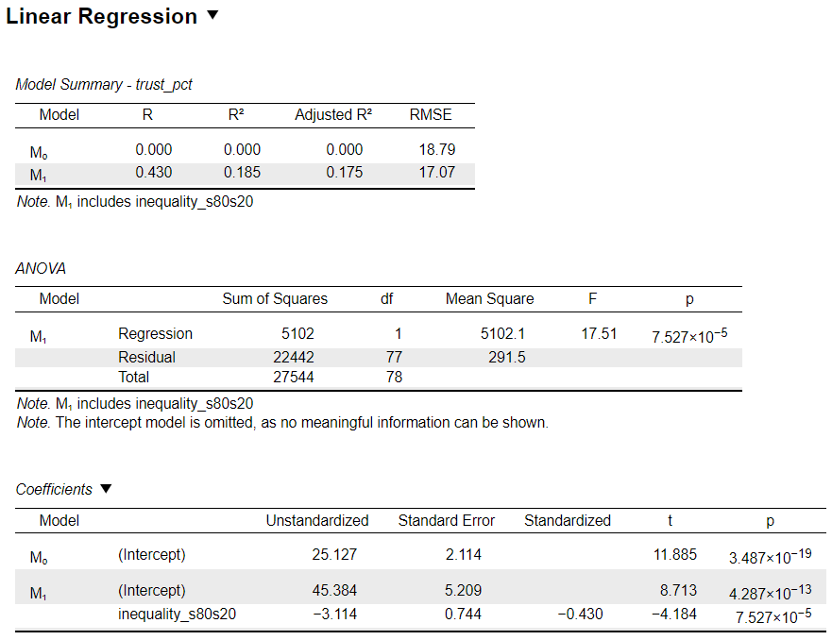
Inequality → Social trust

Slide 15
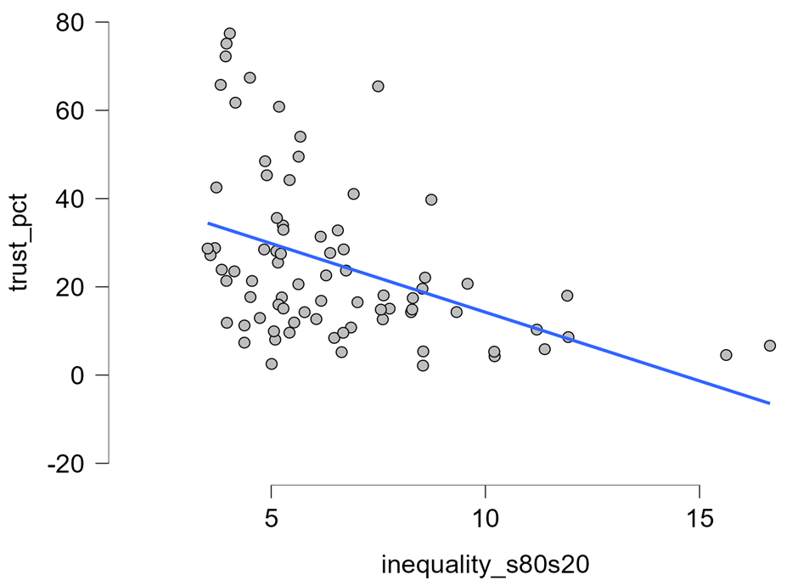
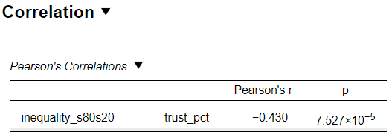
Inequality ←→ Social trust

Slide 16
Inequality → Social trust

Slide 17
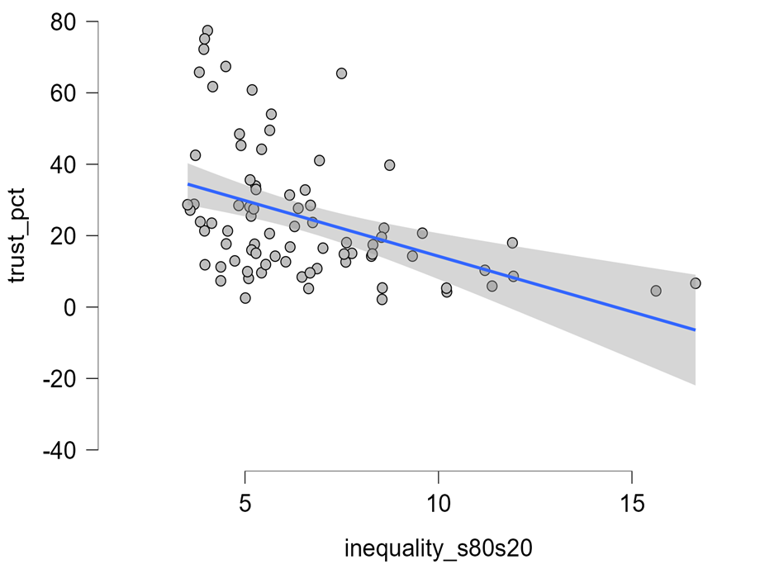
Inequality → Social trust

Slide 18
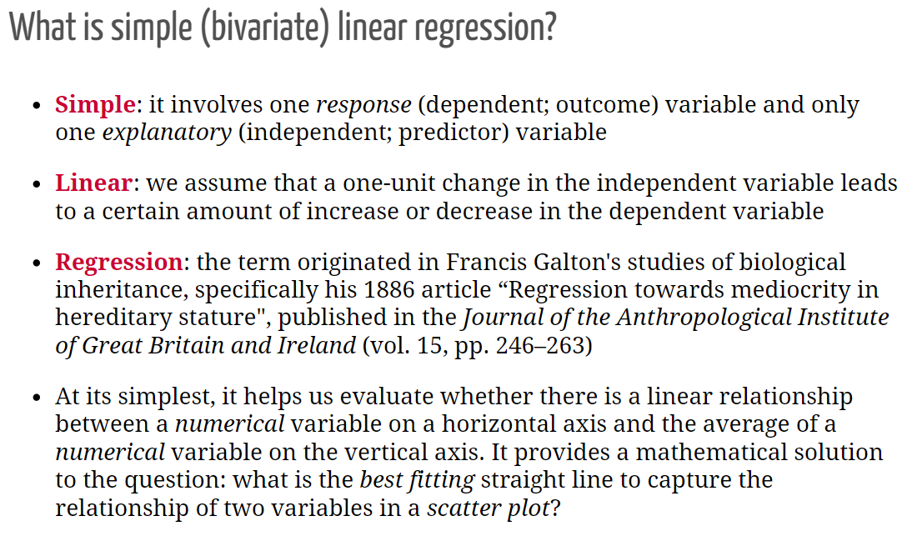

Slide 19
What is a ‘best’ line?
The same regression line could represent very different relationships
Source: F. J. Anscombe (1973). Graphs in Statistical Analysis. The American Statistician, 27(1):17-21. If you have access to JSTOR you can get the article at the following link: http://www.jstor.org/stable/2682899

Slide 20
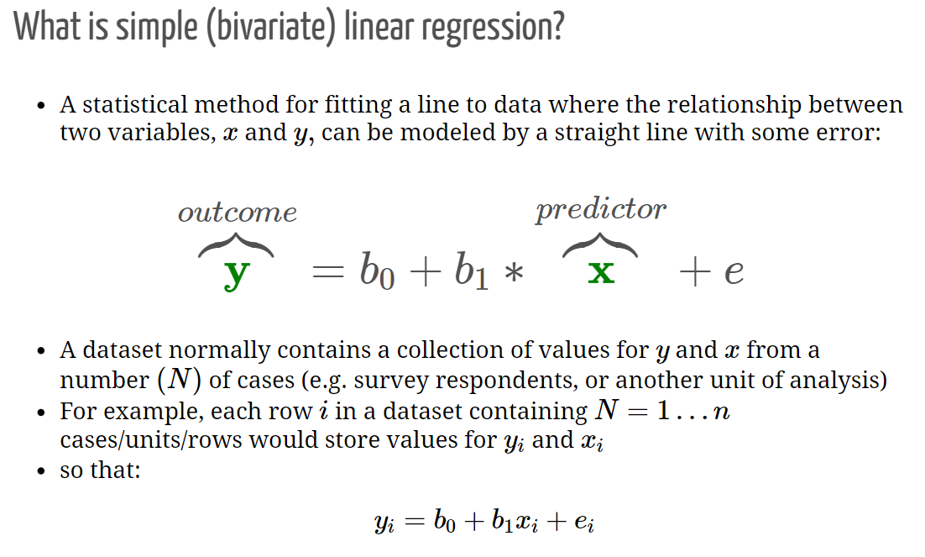

Slide 21
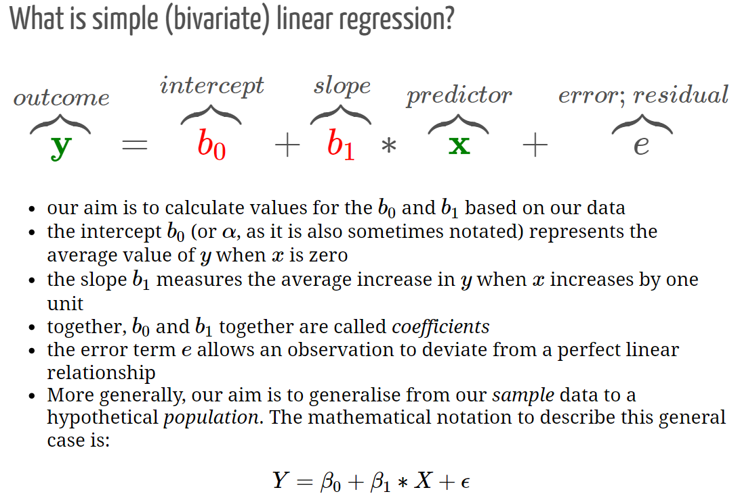

Slide 22
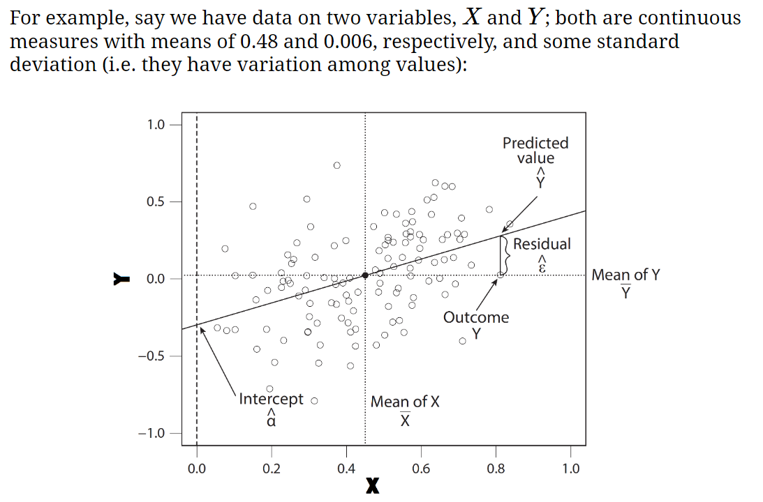

Slide 23
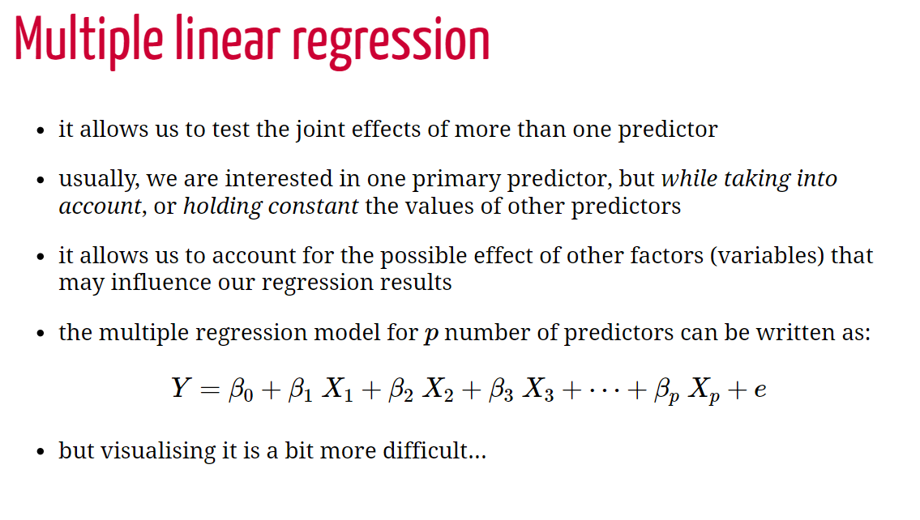

Slide 24
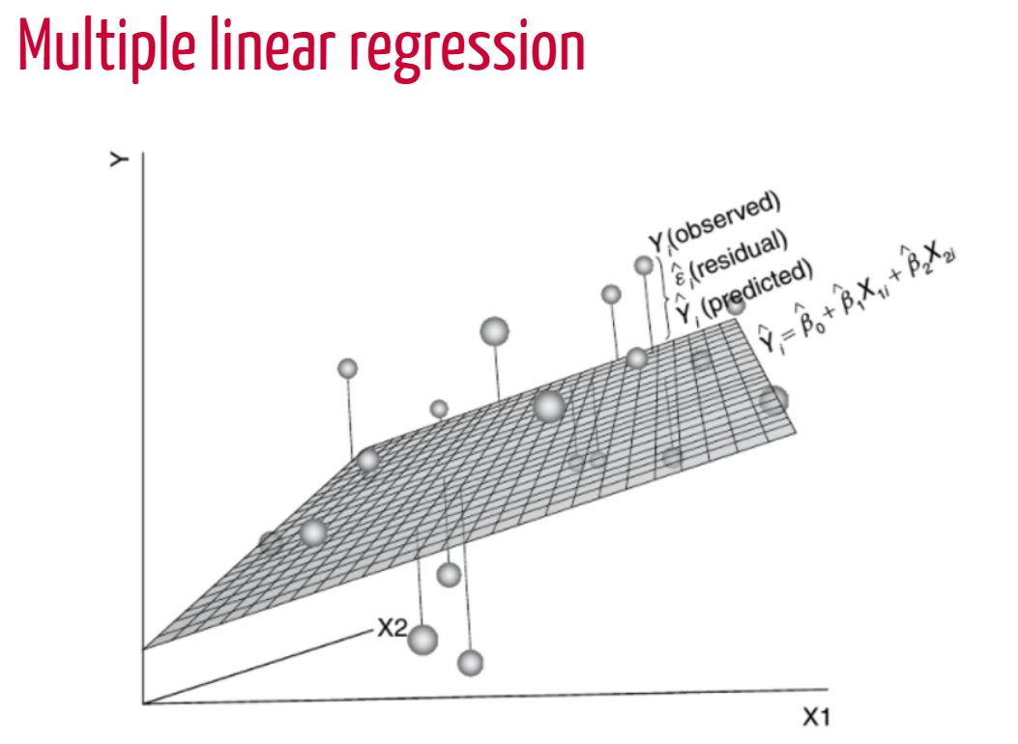
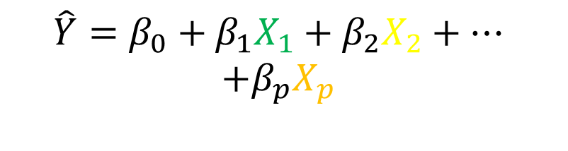
$$\hat{Y}=β_{0}+β_{1}X_{1}+β_{2}X_{2}+…$$
$$+β_{p}X_{p}$$
X1
X2
X3
60%
unexplained

Slide 25
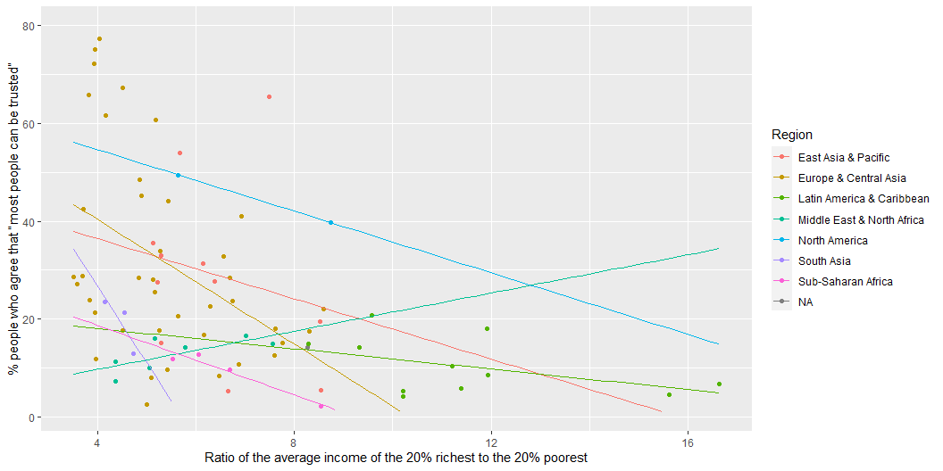
Inequality + Region → Social trust

Slide 26
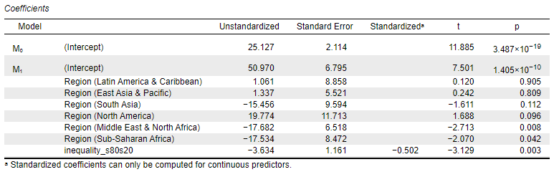
Inequality + Region → Social trust

Slide 27
Workshop
1-3pm

Slide 28
Assignment Questions
A. Are religious people more satisfied with life?
B. Are older people more likely to see the death penalty as justifiable?
C. What factors are associated with opinions about future European Union enlargement among Europeans?
D. Is higher internet use associated with stronger anti-immigrant sentiments?
E. How does victimisation relate to trust in the police?
F. What factors are associated with belief in life after death?
G. Are government/public sector employees more inclined to perceive higher levels of corruption than those working in the private sector?

